Slide 1
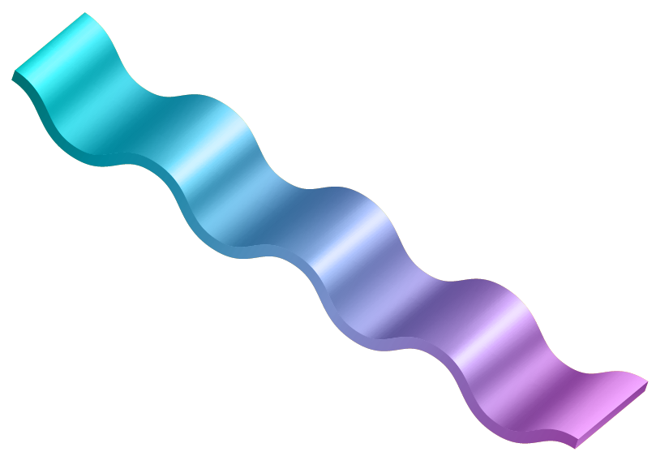
Properties of
Shapes
Talk 1
Sayantika Mondal
Mathematics

Slide 2
WhAT is the shape of SPace?

Slide 3
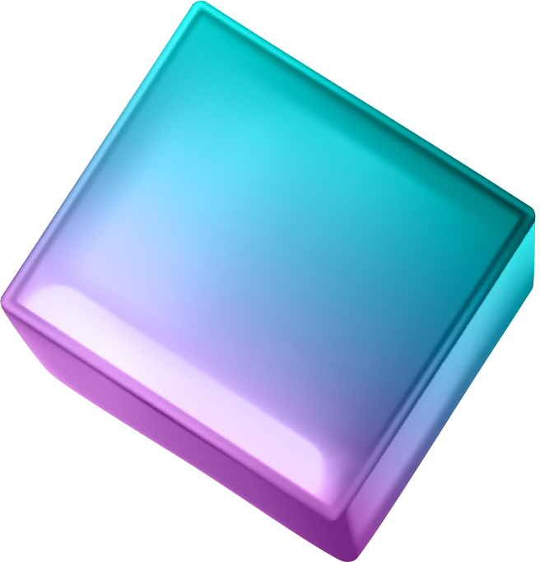
SUrfaces

Slide 4
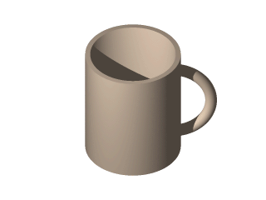
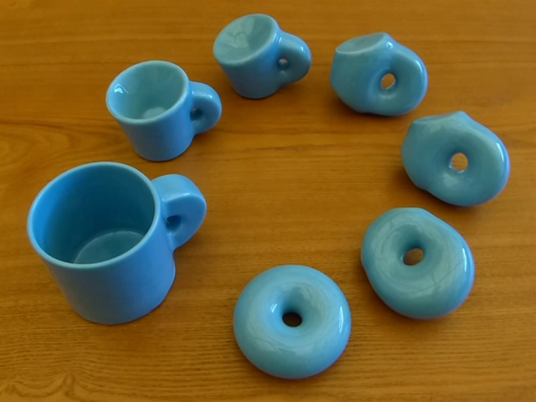
Properties
1. Holes
Genus = Number of holes

Slide 5
Other examples:

Slide 6
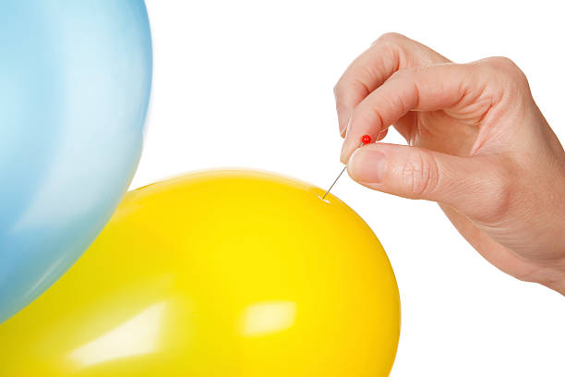
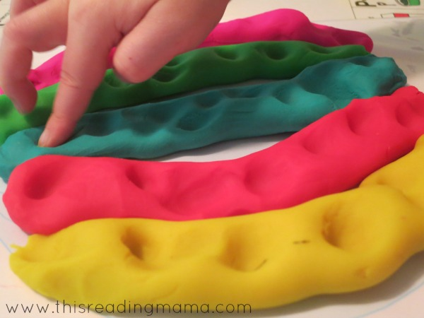
Properties
1. Punctures
.
.
.
How are they different?
VS

Slide 7
Classification of Surfaces
All surfaces are determined by number of holes and punctures.
Genus 0
Genus 1
Genus 2
Genus 3
.
.
All shapes are really just made up of donuts or donuts with holes
Genus = 2, Punctures = 2

Slide 8
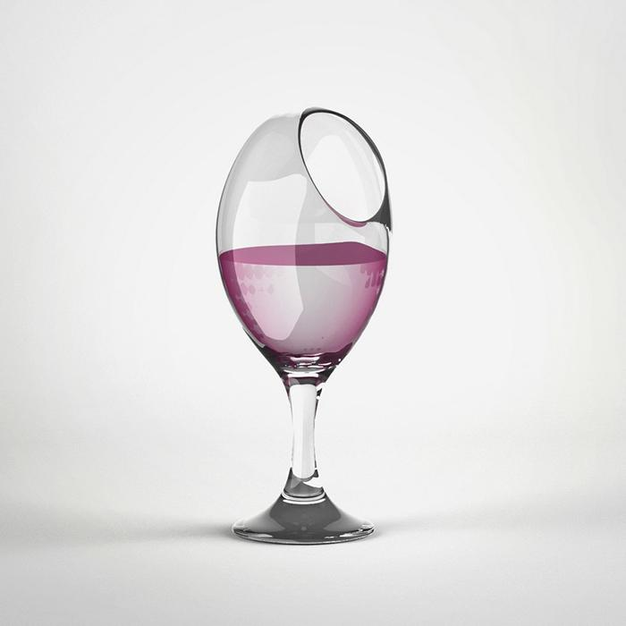
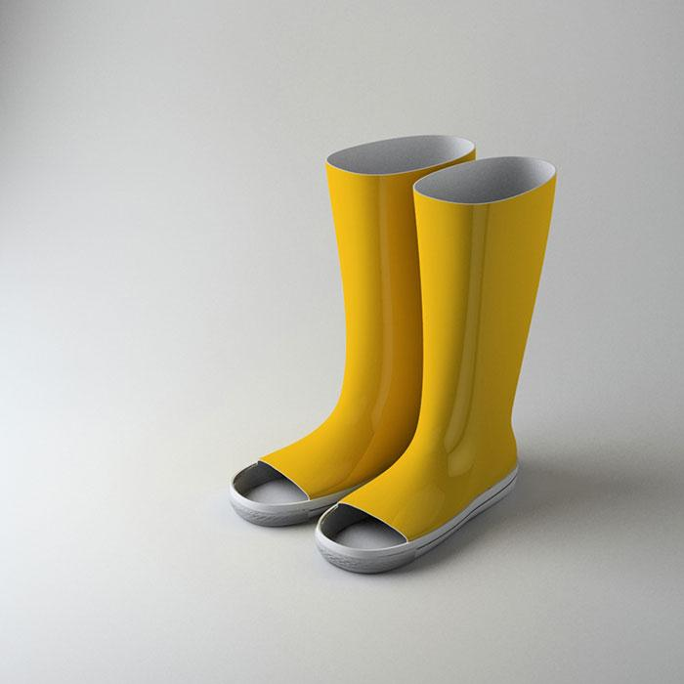
Q
How many donuts do we need for these?

Slide 9
Thank Y0U!
smondal@gradcenter.cuny.edu

